Slide 1
Digital Portfolio
STUDENT NAME: A.lakshmi
REGISTER NO AND NMID: 30324U18063
DEPARTMENT: computer science
COLLEGE: COLLEGE/ UNIVERSITY

Slide 2


Slide 3

Five key types of cybersecurity are network security, application security, information security, cloud security, and endpoint security. These types focus on protecting different digital assets and systems by safeguarding networks from threats, securing software during development, protecting data, securing cloud-based infrastructure, and protecting individual devices like computers and mobile phones.
3/21/2024 Annual Review

Slide 4
Network security is a specialized branch of cybersecurity focused on protecting an organization's entire IT infrastructure, including hardware, software, and data, from threats and unauthorized access. It achieves this by implementing security measures such as firewalls, VPNs, antivirus software, access controls, and network monitoring to ensure data integrity, confidentiality, and availability.

Slide 5
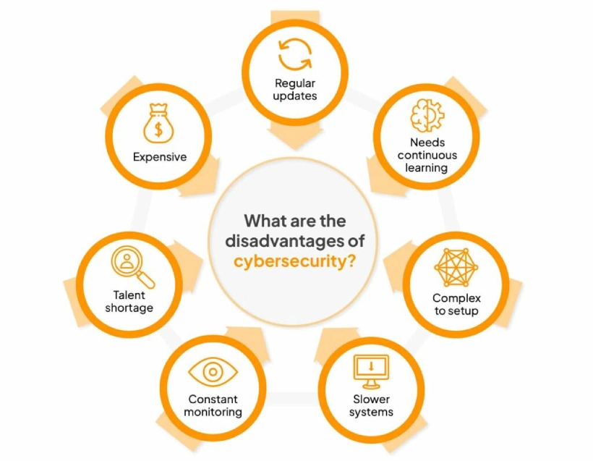

Slide 6

The benefits of cybersecurity include protecting sensitive personal and business data, preventing costly data breaches and financial fraud, ensuring business continuity and operational efficiency, maintaining customer trust and a positive reputation, meeting regulatory compliance, safeguarding intellectual property, and reducing the overall risk of cyberattacks and their associated financial and operational impacts.

Slide 7
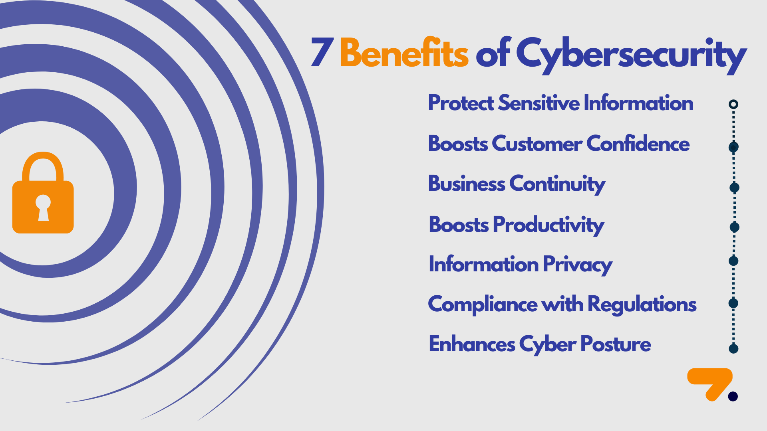

Slide 8
Common Cyber Threats Malware: Malicious software that can damage systems or steal information. Ransomware: A type of malware that encrypts a user's files and demands payment for their release. Phishing: Fraudulent attempts to obtain sensitive information, such as usernames, passwords, and credit card details, by disguising oneself as a trustworthy entity in electronic communication. Social Engineering: Psychological manipulation to trick individuals into giving up confidential information or performing actions that compromise security.
8

Slide 9
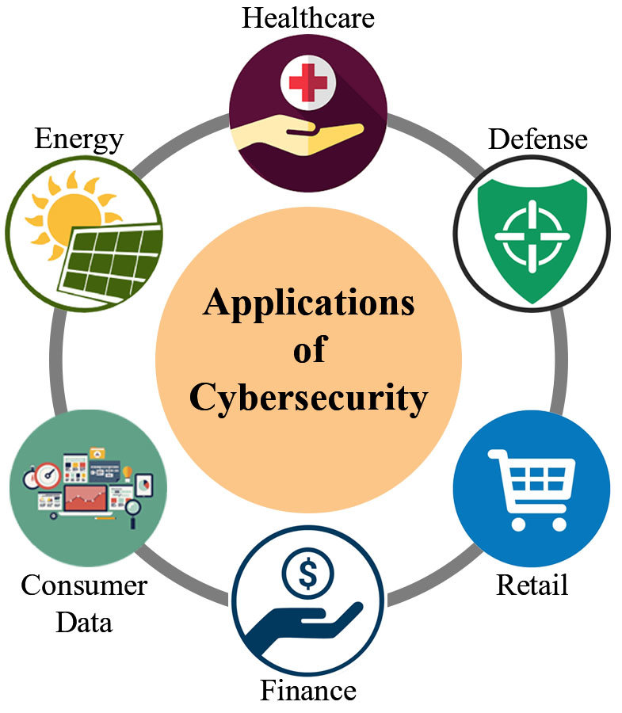

Slide 10
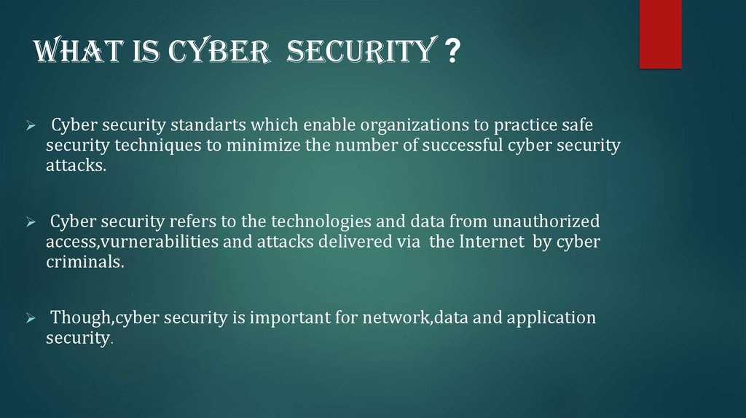
3/21/2024 Annual Review
10

Slide 11
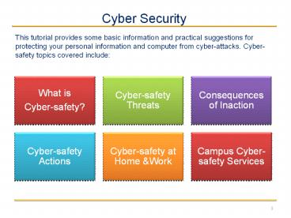
11

Slide 12
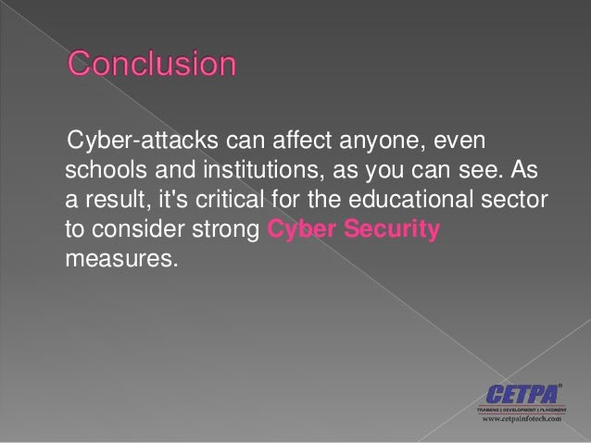
3/21/2024 Annual Review
0

